Slide 1
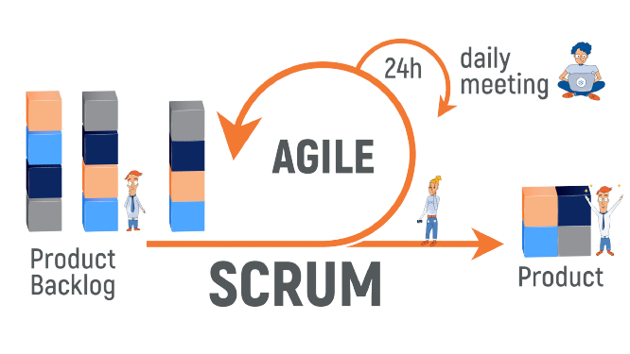
Scrum Agile Project Management Framework

Slide 2
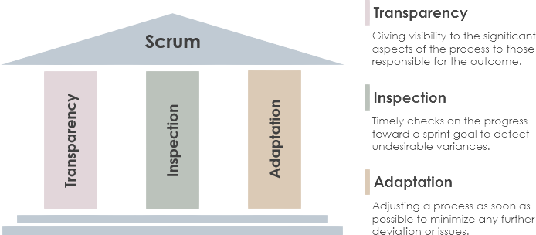
INTRODUCTION
Welcome and Introduction to Scrum
Definition: Scrum is an agile project management framework designed to deliver value through iterative and incremental development.
Key principles: Transparency, Inspection, Adaptation

Slide 3
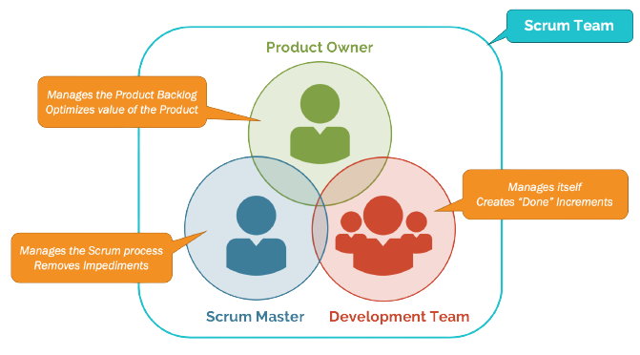
Scrum Roles
Product Owner: Represents the stakeholders, defines and prioritizes product backlog items.
Scrum Master: Facilitates the Scrum process, removes impediments, and ensures adherence to Scrum principles.
Development Team: Self-organizing team responsible for delivering the product increment.

Slide 4
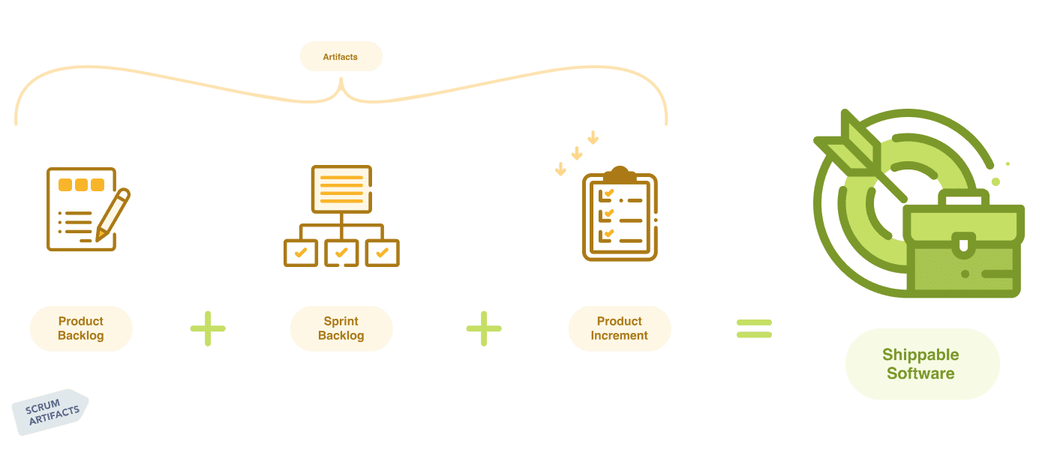
Scrum Artifacts
Product Backlog: Prioritized list of user stories, features, and enhancements.
Sprint Backlog: Subset of the product backlog items selected for the current sprint.
Increment: The sum of all the product backlog items completed during a sprint.

Slide 5
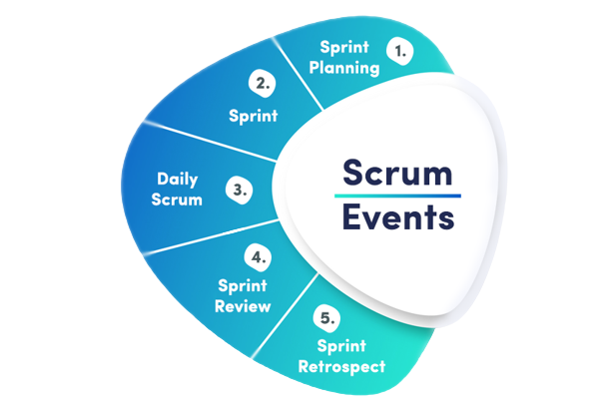
Scrum Events
Sprint Planning: Collaborative session to define the sprint goal and select backlog items for the sprint backlog.
Daily Scrum: Daily 15-minute stand-up meeting for the development team to synchronize and plan the day's work.
Sprint Review: Review of the increment with stakeholders and gathering feedback.
Sprint Retrospective: Reflection on the previous sprint to identify improvements and adapt the process.

Slide 6
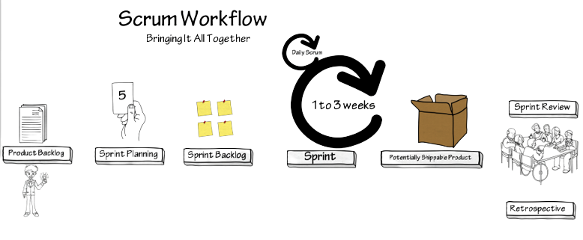
Scrum Workflow
Product Backlog Refinement: Regular activity to refine and prioritize the product backlog.
Sprint: Time-boxed iteration (usually 1-4 weeks) where the team works to deliver a potentially shippable increment.
Sprint Planning: Collaborative session to plan the upcoming sprint.
Daily Scrum: Short daily meetings to ensure synchronization and discuss progress.
Sprint Review: Demo of the increment to stakeholders and gathering feedback.
Sprint Retrospective: Reflect on the sprint and identify areas for improvement.

